Slide 1
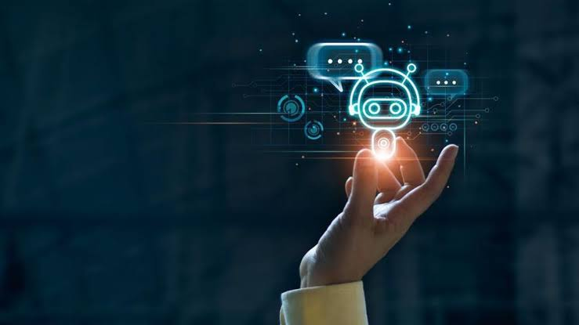
WELLNESS COMPANION BOT
PRESENTED BY,
PADMAPRIYA.S
PRIYADHARSHINI.K
RAGAVI.S

Slide 2
INTRODUCTION :
Due to increasing mental illness and loneliness among children and adults, they need something that could help them cope with it. Depression can be caused by many ways, such as a death of a loved one, a divorce or a breakup of a relationship, being victimized and physical abuse. People going through depression often feel completely alone.
But mental health advocates urge people to communicate. For these types of situations, there has to be some way for the individuals to express their emotions and feelings.
Chat-bot will gather information about the users feelings through text from user via method. chat-Bot not only to chat but to help the user cope with mental health issues by giving advice. The chat-Bot dialogues are predefined and thus only respond to a limited number of questions which can be increased with regular updates result shows that the loneliness of adult people decreased.

Slide 3
EXISTING SYSTEM:
In Existing system,Kai companion,a Bot permits humans to interact with digital devices as if they were communicating with a human being. Al bots employ machine learning, an Al capability that allows bots to become smarter over time as they are used. Bots are a natural match for customer service because of this, bots use digital instant messenger to communicate with people and can be integrated into a variety of applications and websites.

Slide 4
PROBLEM STATEMENT :
Kai companion is still in its prime and there is a lot of issues and bugs which causes user dissatisfaction.
Inability to Understand Chatbots cannot respond properly, due tofixed programs if an unsaved query is introduced to them. This leads to customer dissatisfaction and may result in the loss Kai companion is still in its trail version and soon will only be usuable on subscription which is a disadvantage for people who cant afford the service.
• Kai doesn't include any special features rather than consultation

Slide 5
PROPOSED SYSTEM:
Our wellness companion normalizes the concept of mental wellness. we can feel the essence of positive vibes receiving positive messages besides chatting, we can listen to calming music or play mini-games, play quizzes, etc. Similarly, it has weather/Crypto forecasting to feel updated and also acts as a translator or remainder. All these activities can make everyone entertained conversational interfaces as they are also known no longer will you have to learn a foreign language to communicate with others current trends on virtual presence will provide the groundwork for truly immersive communication designed to transcend time and space. The future there will be a way to automate responses based on pre-written keywords and through machine learning.

Slide 6
ADVANTAGES OF PROPOSED SYSTEM :
24-7 availability - answer queries at any time. people reach out to them later as they trace their activities during non working hours.
It is more efficient and easy to implement by anyone.
Reduced Costs -receiving multiple queries at a time as it eliminates the requirement of any manpower during online communication.
Provides better features with the needs of the users to entertain themselves and learn and to improve themselves.

Slide 7
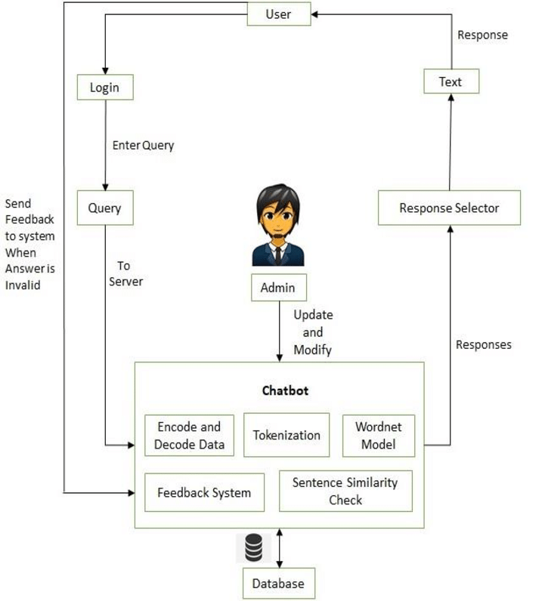
SYSTEM ARCHITECTURE:

Slide 8
SYSTEM REQUIREMENTS:
SOFTWARE REQUIREMENTS
PYTHON 3.7.2
DISCORD.JS 2.0.5
TENSORFLOW 1.1.0
PYLANCE 0.19.1
AIOSQLITE 1.12.1
RANDOM 2.7.0
OPENCV OR OPVENCV2
VISUAL STUDIO 17.1
AIOSYNIC 2.3.2
WINDOWS 10/11 OPERATING SYSTEM

Slide 9
HARDWARE REQUIREMENTS:
2.0GHz AMD A4-9425 64bit PROCESSOR
4GB/8GB RAM
5GB HARD DISK SPACE

Slide 10
CONCLUSION AND FUTURE WORK
Minimal human interference in the use of devices is the goal of our world of technology. Chatbots can reach out to a broad audience on messaging apps and be more effective than humans are. At the same time, they may develop into a capable information-gathering tool. They provide significant savings in the operation of customer service departments. With further development of Al and machine learning, somebody may not be capable of understanding whether he talks to a chatbot or a real-life agent.
Further work of this research would be exploring in detail existing chatbot platforms and compare them. It would also be interesting to examine the degree of ingenuity and functionality of current chatbots.

Slide 11
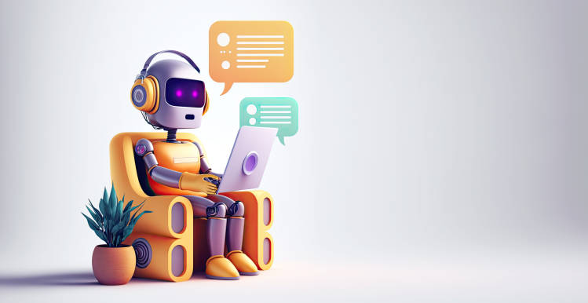
THANK
YOU

